Slide 1
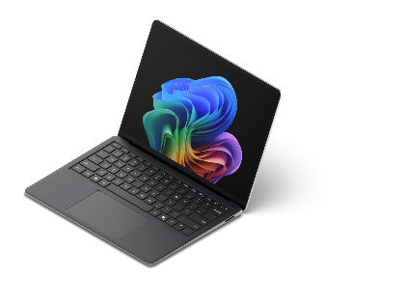

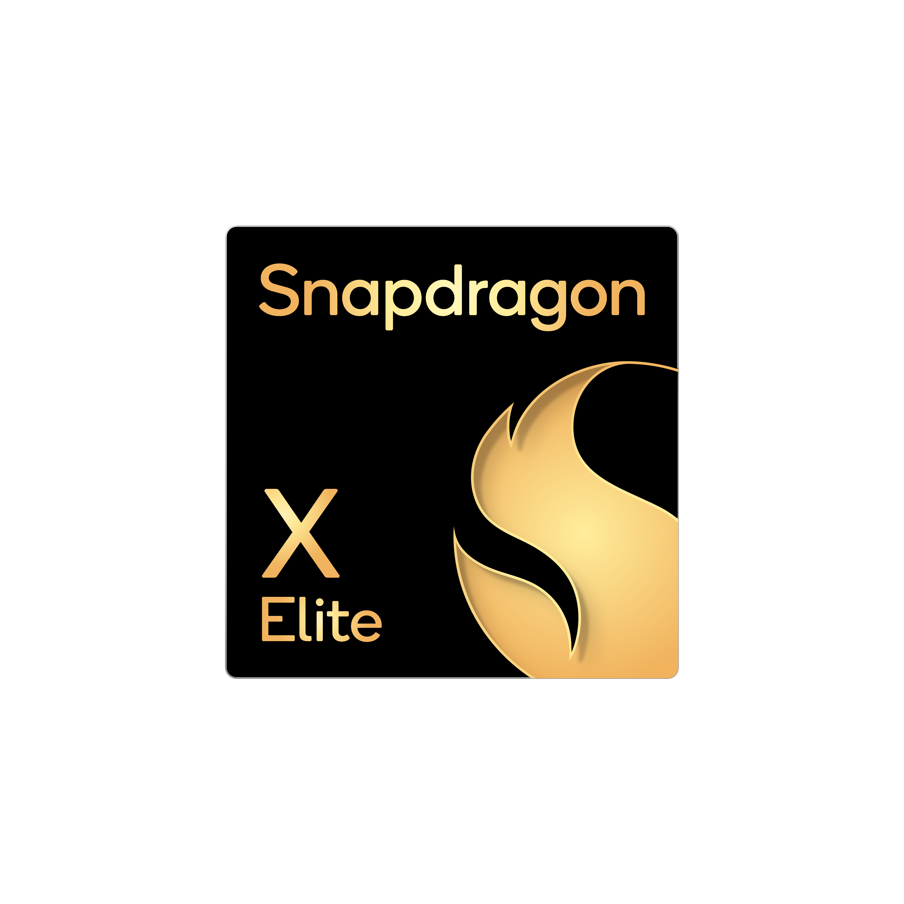

Surface 5G Portfolio
 | Surface Pro 10 5G for Business | Surface Pro 5G for Business | Surface Laptop 5G for Business
Processor | Intel® Core™ Ultra 5 (Series 1) or Intel® Core™ Ultra 7 (Series 1) | Snapdragon® X Plus (10 Core) or Snapdragon® X Elite (12 Core) | Intel® Core™ Ultra 5 (Series 2) or Intel® Core™ Ultra 7 (Series 2)
NPU | Intel® AI Boost NPU | Qualcomm® Hexagon™ NPU with 45 TOPS | Intel® AI Boost NPU with up to 48 TOPS
Display | 13-inch² PixelSense™ Flow touchscreen with adaptive color Anti-reflective technology Compatible with Microsoft Pen Protocol (MPP) for consistent, responsive inking with Surface Slim Pen⁶ | 13-inch² PixelSense™ Flow touchscreen with adaptive color, adaptive contrast, and HDR support⁵ Optional OLED display with 1:M contrast ratio Compatible with Microsoft Pen Protocol (MPP) for consistent, responsive inking with Surface Slim Pen⁶ | 13.8-inch² PixelSense™ Flow touchscreen with adaptive color and HDR support⁵ Anti-reflective technology
Ports | 2 x USB-C® with Thunderbolt™ 4 ports Supports a full laptop experience with Surface Pro 13-inch Keyboard⁷ Connects up to two 4K monitors⁸ | 2 x USB-C® with USB4® ports Supports a full laptop experience with Surface Pro 13-inch Keyboard⁷ Connects up to three 4K monitors⁸ | 2 x USB-C® with Thunderbolt™ 4 ports Connects up to two 4K monitors⁸
Security | TPM 2.0 | TPM 2.0 Microsoft Pluton | TPM 2.0 Microsoft Pluton
Battery life | Up to 16 hours of battery life with typical device usage connected by cellular⁹ | Up to 9 hours of battery life with active web usage⁹ | Up to 12 hours of battery life with active web usage and up to 20 hours of local video playback⁹
Fast charging | Supported with minimum 45W Surface power supply via Surface Connect or USB Type-C® PD charger¹⁰ | Supported with minimum 65W Surface power supply via Surface Connect or 60W USB Type-C® PD charger¹⁰ | Supported with minimum 65W Surface power supply via Surface Connect or 60W USB Type-C® PD charger¹⁰
Cameras | 1440p Quad HD front-facing camera supporting Windows Hello facial authentication and ultrawide field of view 10.5 MP Ultra HD rear-facing camera | 1440p Quad HD front-facing camera supporting Windows Hello facial authentication and ultrawide field of view 10 MP Ultra HD rear-facing camera | 1080p Full HD front-facing camera supporting Windows Hello facial authentication
Storage | Up to 64GB of RAM Up to 1TB storage¹⁶ | Up to 16GB of RAM Up to 512GB storage¹⁶ | Up to 32GB of RAM Up to 1TB storage¹⁶
Versatile performance on the go with 5G connectivity¹ and AI-ready silicon.
These 5G Surface devices feature:
NanoSIM and eSIM support³
Secure, reliable Wi-Fi 7⁴ & Bluetooth® Core 5.4 connectivity
NPUs powering on-device AI capabilities
Windows 11 Secured-core PC technology
PixelSense™ Flow touchscreen with adaptive color providing a consistent viewing experience in different environments
Front-facing Surface Studio Camera supporting Windows Hello for Business with facial recognition and Enhanced Sign-In Security (ESS) and AI-enhanced Windows Studio Effects
Dual Studio Mics with voice focus¹³
Simplified repairs with replaceable components and built-in instructional
QR code¹⁴
Surface Management Portal for management and monitoring¹⁵
¹5G not available in all areas; compatibility and performance depend on carrier network, plan and other factors. See carrier for details and pricing. ²Display has rounded corners within a standard rectangle. Size is measured diagonally as a standard rectangular shape (actual viewable area is less). ³eSIM support may vary by carrier. ⁴6GHz band not available in all regions. ⁵HDR requires HDR content and enabling HDR in device settings. ⁶Surface Slim Pen sold separately. Software license required for some features. ⁷Surface Pro 13-inch Keyboards sold separately. ⁸With compatible docks. ⁹Battery life varies significantly based on usage, network and feature configuration, signal strength, settings, and other factors. See aka.ms/SurfaceBatteryPerformance for details. ¹⁰Specific configurations come with 39W Surface Power Supply in select markets. Power supply and chargers supporting fast charging are sold separately. Testing conducted by Microsoft in 2024. For details on fast charging see USB-C and fast charging for Surface. ¹³Voice focus requires activation, requires Windows 11 and is available in apps which use integrated device microphones and use certain Windows audio processing modes. ¹⁴Replacement components available through Surface Commercial authorized device resellers. Components can be replaced on-site by a skilled technician following Microsoft’s Service Guide. Microsoft tools (sold separately) may also be required. Availability of replacement components and service options may vary by product, market and over time. See Surface service options - Surface | Microsoft Learn. Opening and/or repairing your device can present electric shock, fire and personal injury risks and other hazards. Use caution if undertaking do-it-yourself repairs. Unless required by law, device damage caused during repair will not be covered under Microsoft’s Hardware Warranty or protection plans. ¹⁵Requires Microsoft Intune. ¹⁶System software uses significant storage space. Available storage is subject to change based on system software updates and apps usage. 1 GB = 1 billion bytes. 1 TB = 1,000 GB. See Surface Storage for more details.

